Slide 1
Officer Positions
Finance
Facilities
Membership
Taskmaster
Education
Board
-Pays bills
-Does financial reimbursements via checks
-Sends credits/fines, budgets, bank statements and utility data to SHC
-Liaison for finance committee
-Keep lists of facilities concerns
-Facilitating maintenance projects
-Liaison for facilities committee
-Communicate with member prospects and schedule visits
-Inform prospects of approval status
-Liaison for membership committee
-Monitors assigned chore completion
-Manage chore details, tactics, and schedule
-Report chore fines/credits to finance officer
-Submits constitution revisions to VP of education
-Responsible for photo albums of house activities
-Liaison for educations committee
-Liaison for the SHC executive committee, communicating big stuff from top-down
Additional Roles (Some are Optional)
Project Manager
Garden Keeper
Minute Taker
Chore Roles
-Facilitates all projects whenever necessary
-Organizes and monitors house projects
-Tracks member contributions
-Facilitates most meetings
-Fills work gaps
Lawn Keeper
House Shopper
Office Labor
Meeting Facilitator
Grabber Eat (Always Taken)

Slide 2
Membership
Grabber Eat
Facilities
Finance
Taskmaster
Project Manager
Meeting Facilitator
Office Labor
House Shopper
Education
Impact On House
Board
Lawn Keeper
Garden Keeper
Minute Taker
Chore Roles
Interest (i.e. - Personal Investment)

Slide 3
Browse RACI Chart

Slide 4
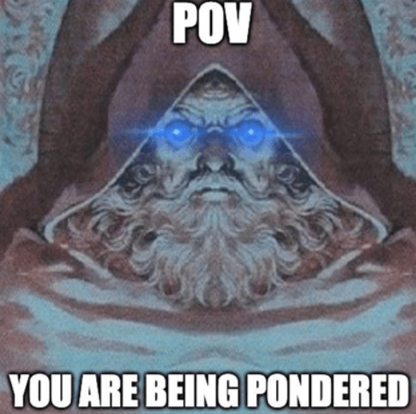
PONDER:
What should we expect from officers each meeting?

